Slide 1

Oxygenated
Water
Here is where your presentation begins

Slide 2
Contents of this template
You can delete this slide when you’re done editing the presentation
Fonts | To view this template correctly in PowerPoint, download and install the fonts we used
Used and alternative resources | An assortment of graphic resources that are suitable for use in this presentation
Thanks slide | You must keep it so that proper credits for our design are given
Colors | All the colors used in this presentation
Icons and infographic resources | These can be used in the template, and their size and color can be edited
Editable presentation theme | You can edit the master slides easily. For more info, click here
For more info: SLIDESGO | BLOG | FAQS
You can visit our sister projects: FREEPIK | FLATICON | STORYSET | WEPIK | VIDEVO

Slide 3
Table of contents
01
02
03
04
Name of the section
Name of the section
You can describe the topic of the section here
You can describe the topic of the section here
Name of the section
Name of the section
You can describe the topic of the section here
You can describe the topic of the section here

Slide 4
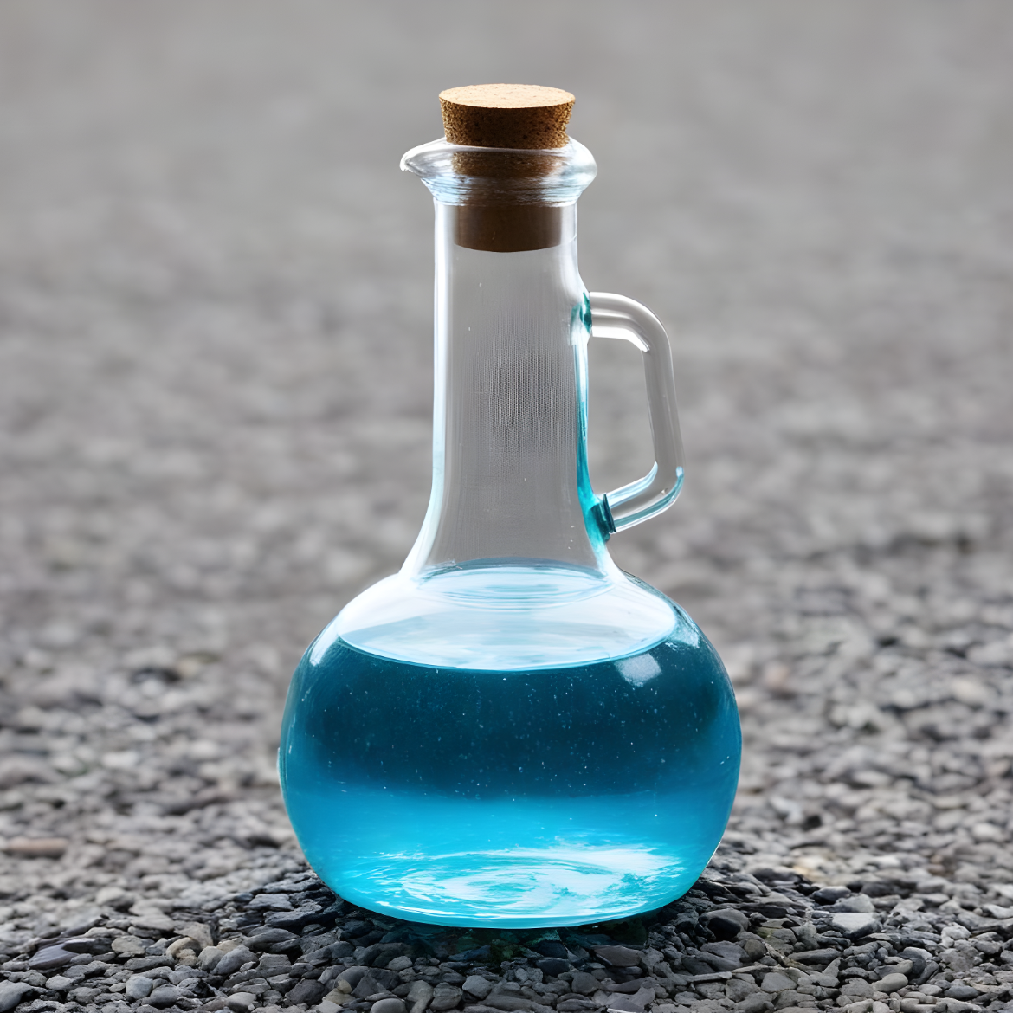
Introduction
Here you can give a brief description of the topic you want to talk about. For example, if you want to talk about Mercury, you can say that it’s the smallest planet in the entire Solar System

Slide 5
Whoa!
This can be the part of the presentation where you introduce yourself, write your email…

Slide 6
01
Name of
the section
You can enter a subtitle here if you need it

Slide 7
The slide title goes here!
Do you know what helps you make your point crystal clear? Lists like this one:
They’re simple
You can organize your ideas clearly
You’ll never forget to buy milk!
And the most important thing: the audience won’t miss the point of your presentation

Slide 8
Do you need longer text?
Mercury is the closest planet to the Sun and the smallest one in the entire Solar System. This planet's name has nothing to do with the liquid metal, since Mercury was named after the Roman messenger god. Despite being closer to the Sun than Venus, its temperatures aren't as terribly hot as that planet's
Its surface is quite similar to that of Earth's Moon, which means there are a lot of craters and plains. Speaking of craters, many of them were named after artists or authors who made significant contributions to their respective fields

